Slide 1
Bash Scripting

Slide 2
The Header
On the first line
#! (known as “shebang”)
Followed by path to Bash or env: #!/usr/bin/env bash #!/bin/bash
This is executed via the kernel system called execve()
Kernel checks for #! And passes the path to the original program as a command-line argument
So ./myscript.sh, with #!/bin/bash would have the kernel execute /bin/bash ./myscript.sh
Perl, Python, Expect, awk, and Bash can use #!

Slide 3
Executing the Script
Make script executable with chmod u+x Add execute permission for the “user”, which means the owner of the script file
With only read permission, execute a script with bash thescript.sh
If the directory that contains the script, like the current directory (.), is not in your path, then you normally run the script this way: ./thescript.sh
There is no need to give a script any special name, but a .sh suffix is common and informative.

Slide 4
Variables
Use variables to store values
Values are stored as strings
Math operators are used to convert from string to numbers for calculations
No need to declare variable. str=“Hello” echo $str
Notes:
Line 2 creates a variable called STR and assigns the string "Hello World!" to it. Then the value of this variable is retrieved by putting the '$' in at the beginning.

Slide 5
No Type-Casting
A variable can hold number or characters count=0 count=Zero
Switching variable type can lead to confusion
\ is the bash escape character and it preserves the literal value of the next character that follows $ls \* ls: *: No such file or directory
Notes:
Switching the TYPE of a variable can lead to confusion for the writer of the script or someone trying to modify it, so it is recommended to use a variable for only a single TYPE of data in a script.

Slide 6
Single and Double Quotes
When assigning character data containing spaces or special characters, the data must be enclosed in either single or double quotes.
Double quotes expand variables $var=“test string” newvar=“value of var is $var” echo $newvar value of var is test string
Single quotes do not expand variables $var=“test string” newvar=‘value of var is $var’ echo $newvar value of var is $var

Slide 7
Back Quote
For command substitution `command` $LIST=`ls` $echo $LIST file1.txt file2.txt $PS1=“`pwd->`” /home/userid/homework

Slide 8
The read Command
Read one line of standard input and assign each word to the corresponding variable, with all leftover words assigned to the last variable. $read first last address Sarah Caldwell 123 Main Street $echo “$last, $first\n$address Caldwell, Sarah 123 Main Street

Slide 9
The let Command
Use the let command to do math operations: $let x=10+2*7 $echo $x 24 $let y=x+2*4 $echo $y 32

Slide 10
Arithmetic Expressions
An arithmetic expression can be evaluated by $[expression] or $((expression)): $echo “$((123+20))” 143 $VALORE=$[123+20] $echo “$[123*$VALORE]” 17589

Slide 11
Arithmetic Operations
Available operators: +, -, *, /, % $ cat arithmetic.sh #!/bin/bash echo -n “Enter the first number: ”; read x echo -n “Enter the second number: ”; read y add=$(($x + $y)) sub=$(($x - $y)) mul=$(($x * $y)) div=$(($x / $y)) mod=$(($x % $y)) # print out the answers: echo “Sum: $add” echo “Difference: $sub” echo “Product: $mul” echo “Quotient: $div” echo “Remainder: $mod”

Slide 12
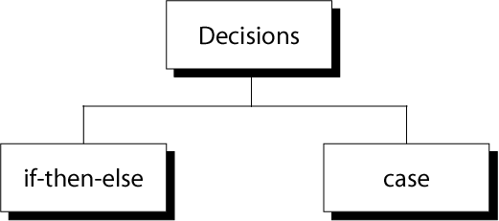
Decision Making

Slide 13
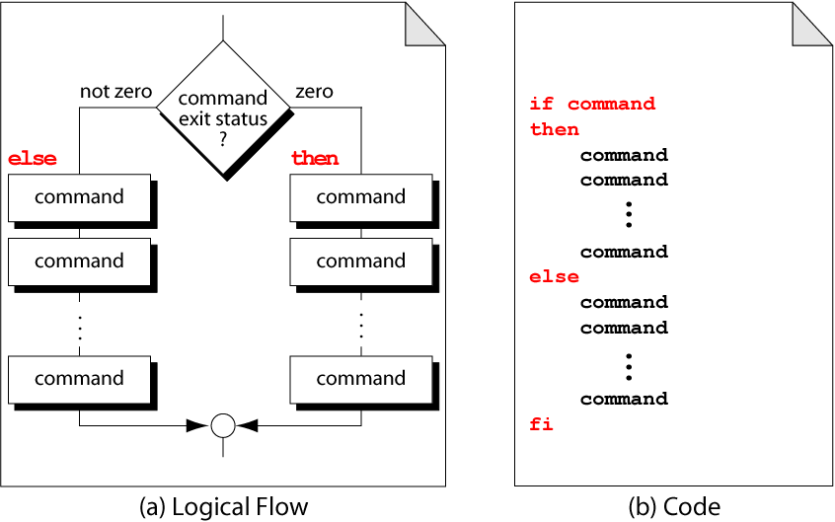
if-then-else Format

Slide 14
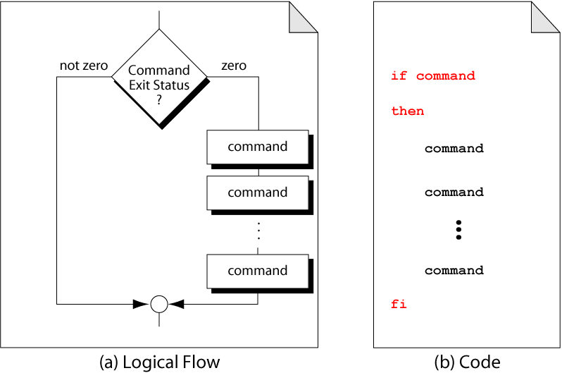
Example of if-then

Slide 15
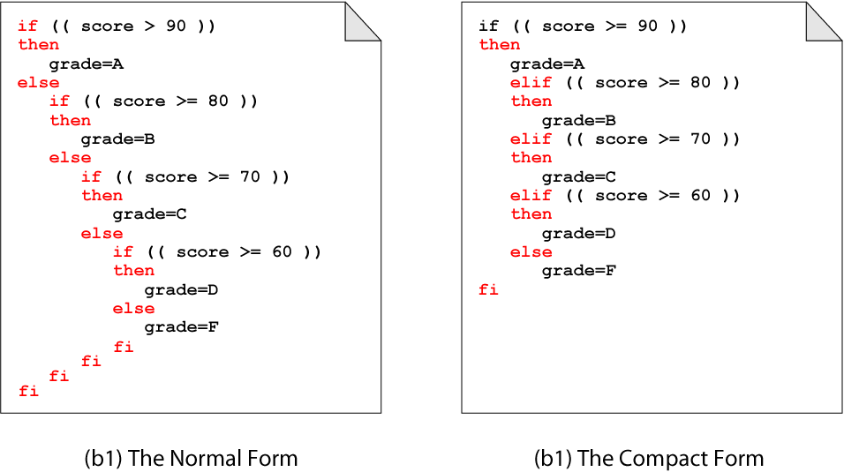
Nested if-then
Notes:
Put spaces after [ and before ], and around the operators and operands.

Slide 16
Nested if-then

Slide 17
String Comparison
= compare if two strings are equal != compare if two strings are not equal -n evaluate if string length is greater than zero -z evaluate if string length is equal to zero
Examples: [ s1 = s2 ] (true if s1 same as s2, else false) [ s1 != s2 ] (true if s1 not same as s2, else false) [ s1 ] (true if s1 is not empty, else false) [ -n s1 ](true if s1 has a length greater then 0, else false) [ -z s2 ](true if s2 has a length of 0, otherwise false)

Slide 18
Number Comparison
-eq compare if two numbers are equal -ge compare if one number is greater than or equal another number -le compare if one number is less than or equal another number -ne compare if two numbers are not equal -gt compare if one number is greater than another number -lt compare if one number is less than another number
Examples: [ n1 -eq n2 ] (true if n1 same as n2, else false) [ n1 -ge n2 ] (true if n1 greater than or equal n2, else false) [ n1 -le n2] (true if n1 is less than or equal n2, else false) [ n1 -ne n1 ](true if n1 not the same as n2 else false) [ n1 -gt n2 ](true if n1 is greater than n2, otherwise false) [ n1 –lt n2 ] (true if n1 is less than n2, otherwise false)

Slide 19
$ cat user.sh
#!/bin/bash
echo -n “Enter your login name: "
read name
if [ “$name” = “$USER” ];
then
echo “Hello, $name. How are you today ?”
else
echo “You are not $USER, so who are you ?”
fi
$ cat number.sh
#!/bin/bash
echo -n “Enter a number 1 < x < 10: "
read num
if [ “$num” -lt 10 ]; then
if [ “$num” -gt 1 ]; then
echo “$num*$num=$(($num*$num))”
else
echo “Wrong insertion !”
fi
else
echo “Wrong insertion !”
fi

Slide 20
File Operators
-d check if path given is a directory
-f check if path given is a file
-e check if file name exists
-r check if read permission is set for file or directory
-s check if a file has a length greater than 0
-w check if write permission is set for a file or directory
-x check if execute permission is set for a file or directory
Examples: [ -d fname ] (true if fname is a directory, otherwise false)
[ -f fname ] (true if fname is a file, otherwise false)
[ -e fname ] (true if fname exists, otherwise false)
[ -s fname ] (true if fname length is greater then 0, else false)
[ -r fname ] (true if fname has the read permission, else false)
[ -w fname ] (true if fname has the write permission, else false)
[ -x fname ](true if fname has the execute permission, else false)

Slide 21
Example
#!/bin/bash if [ -f /etc/fstab ];
then cp /etc/fstab .
echo “Done.”
else echo “This file does not exist.”
exit 1
fi
Exercise
Write a shell script which:
accepts a file name
checks if file exists
if file exists, copy the file to the same name + .bak + the current date (if the backup file already exists ask if you want to replace it).
When done you should have the original file and one with a .bak at the end.

Slide 22
Logical Operators
! negate (NOT) a logical expression
-a logically AND two logical expressions
-o logically OR two logical expressions
Examples: #!/bin/bash
echo -n “Enter a number 1 < x < 10:”
read num
if [ “$num” -gt 1 –a “$num” -lt 10 ];
then
echo “$num*$num=$(($num*$num))”
else
echo “Wrong insertion !”
fi

Slide 23
Logical Operators
&& logically AND two logical expressions
|| logically OR two logical expressions
Examples: #!/bin/bash
echo -n "Enter a number 1 < x < 10: "
read num
if [ “$number” -gt 1 ] && [ “$number” -lt 10 ];
then
echo “$num*$num=$(($num*$num))”
else
echo “Wrong insertion !”
fi

Slide 24
Example
$ cat iftrue.sh
#!/bin/bash
echo “Enter a path: ”; read x
if cd $x; then
echo “I am in $x and it contains”; ls
else
echo “The directory $x does not exist”;
exit 1
fi
$ iftrue.sh
Enter a path: /home
userid anotherid …
$ iftrue.sh
Enter a path: blah
The directory blah does not exist

Slide 25
Case Statement
case expression in
pattern 1 )
command list ;;
Pattern 2 )
command list ;;
…
esac

Slide 26
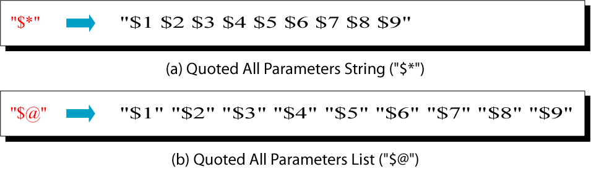
Quoted All Parameters

Slide 27
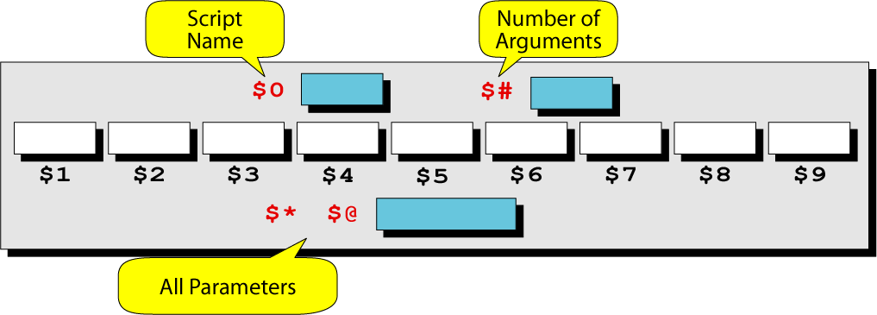
Built-in Parameter Variables

Slide 28
Shell Parameters
Positional parameters are assigned from the shell’s argument when it is invoked. Positional parameter “N” may be referenced as “${N}”, or as “$N” when “N” consists of a single digit.
Special parameters $# is the number of parameters passed $0 returns the name of the shell script running as well as its location in the file system $* gives a single word containing all the parameters passed to the script $@ gives an array of words containing all the parameters passed to the script
$ cat sparameters.sh
#!/bin/bash
echo “$#; $0; $1; $2; $*; $@”
$ sparameters.sh arg1 arg2
2; ./sparameters.sh; arg1; arg2; arg1 arg2; arg1 arg2

Slide 29
Function
Give a name to a sequence of statements that will execute within the shell, not in a new process function NAME { body . . . }

Slide 30
Commonly used to organize code in a shell program function hello { echo hello } hello # shell memorizes the function like it’s a # new command

Slide 31
The Return Command
Functions produce results by writing output like commands do hvar=$(hello)

Slide 32
The exit Command
exit <VALUE> sets the exit status, represented by $? To <VALUE>.
exit terminates the shell process
exit in a function terminates the whole shell program, not just the function

Slide 33
The read Command
Read a line into a variable or multiple variables
read a b – reads first word into a and the rest into b
Convenient for a while loop

Slide 34
Using Coprocesses
A coprocess is a background process where your shell gets file descriptors for the process’s stdin and stdout
Implemented with pipe #!/bin/bash while read line do echo $line | tr “ABC” “abc” done

